Slide 1
Repairables Distribution
Presented by:
Alex Sanchez
NAVSUP WSS N9833
eRMS PM/Transportation SME
September 2024

Slide 2



Navy’s Three-Legged Approach for Repairables Management
Advanced Traceability & Control (ATAC)
Organization which coordinates global transportation
Network of hubs, nodes & expeditionary “mobile” nodes
Packaging & transshipment capabilities
Technical Assistance for
Repairables Processing (TARP)
Expertise in repairables handling, packaging, & eRMS usage
Training of Sailors & Marines
SUP WSS contractors around the world & at sea
Staff ATAC Mobile Nodes on very short notice
Electronic Retrograde
Management System (eRMS)
Automated web program
Used by warfighter in the field
Interfaces directly to NAVSUP WSS systems
Connects supply, maintenance, transportation, & financial processes
Key points of retrograde philosophy
  One-for-one positive inventory control, with signature proof of delivery
  Material screening & automated disposition based on repair requirements
  Expeditious transportation... NAVSUP WSS lives on inventory velocity, not depth
  Cost-effective shipping via consolidation & commercial competition
2
Integration of eRMS, TARP and ATAC Key to Success

Slide 3

Global ATAC Activities
2nd Fleet
Norway
Scotland
Everett, WA
Naples
Bremerton, WA
Sigonella
Souda Bay
South Korea
Iwakuni
Norfolk, VA
Rota
Yokosuka/Atsugi
San Diego, CA
Jacksonville/Mayport, FL
Sasebo
Okinawa
Bahrain
Thailand
Pearl Harbor, HI
7th Fleet
Djibouti
5th Fleet
Philippines
Guam
Singapore
Darwin
3rd Fleet
Edinburgh
Nowra
6th Fleet
4th Fleet
ATAC Hub
ATAC Node
ATAC Mobile Node

Slide 4






eRMS interfaces with Commercial Transportation Carrier Systems

Slide 5



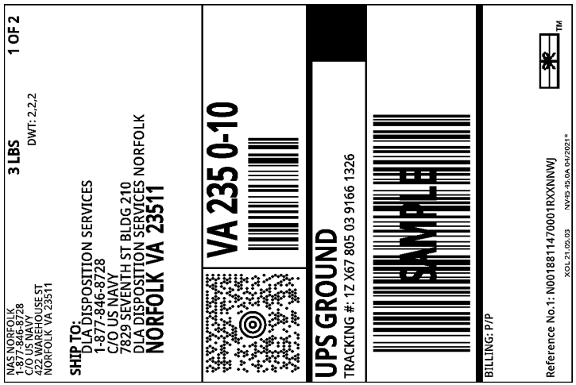
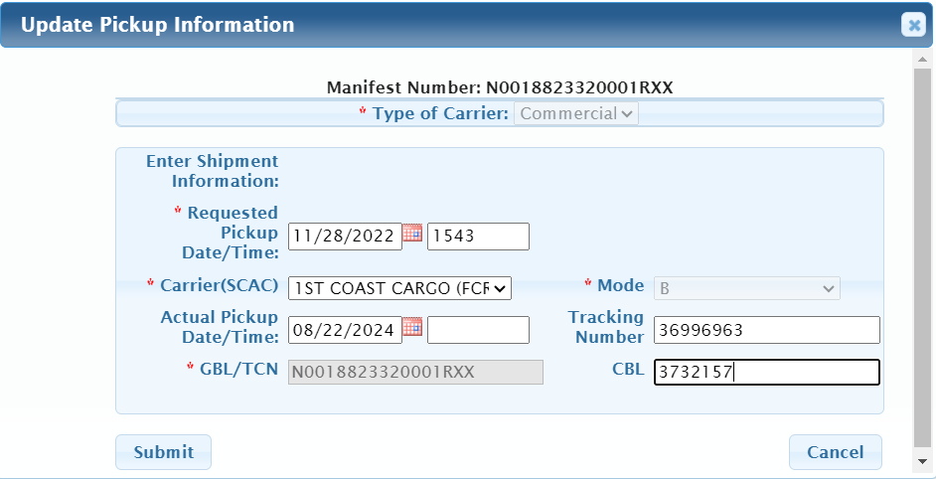

ATAC RFI PROCESS:
CONUS / OCONUS
1) Vendor site enter CAV / RP entry
On the Animation Pane, change the START option to ON CLICK if you want to click to step through the flow manually.
During presentation and while the animations are running and you want the animation to display the whole screen, just click the screen a second time.
6) Labels are cancelled within 5 business days
if not used
2) Pickup Directive (PUD) feeds eRMS
within 24 hrs
X
Routine Priority
6 - 13
5) POS / POD posted in eRMS
via EDI feed or manually
3) ATAC provides labels and carrier info to shipping site
4) Carrier picks up within 24 - 48 hrs or
at scheduled daily pick up time

Slide 6
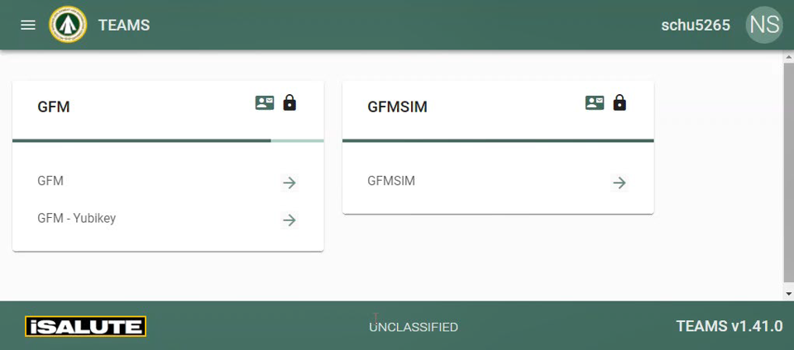


ATAC RFI PROCESS:
Oversize OCONUS Shipment
1) Vendor site enter CAV / RP entry
On the Animation Pane, change the START option to ON CLICK if you want to click to step through the flow manually.
During presentation and while the animations are running and you want the animation to display the whole screen, just click the screen a second time.
6) Labels are cancelled within 5 business days
if not used
2) Pickup Directive (PUD) feeds eRMS
within 24 hrs
X
Routine Priority
6 - 13
5) POS / POD posted in eRMS
via EDI feed or manually
3) ATAC enters shipment information in ETA/GFM for a
6 or 24 hr
spot bid request
4) CBL, AWB, GBL is emailed to vendor with the selected carrier
Notes:
ATAC will arrange pick up for FedEx & UPS

Slide 7








ATAC RFI PROCESS:
CASREP/ HIPRI Shipments CONUS/OCONUS
On the Animation Pane, change the START option to ON CLICK if you want to click to step through the flow manually.
During presentation and while the animations are running and you want the animation to display the whole screen, just click the screen a second time.
Vendor site enters CAVS/RP entry
and emails ATAC CASREP team
ATAC receives an email with a DD1348 Dims & WT
ATAC creates a carrier label offline
Label is emailed to the site to be use within 1 business day
X
ATAC Hi-Pri file left open pending PUD
PUDs feed eRMS within 24 hrs
Labels are cancelled within 5 business days if not used
POS & POD posted in eRMS via EDI feed or manually

Slide 8


ATAC RFI PROCESS:
CASREP Oversize OCONUS Shipments
On the Animation Pane, change the START option to ON CLICK if you want to click to step through the flow manually.
During presentation and while the animations are running and you want the animation to display the whole screen, just click the screen a second time.
Vendor site enters CAVS/RP entry
ATAC receives email with copy of DD1348, DIMS & WT
ATAC enters shipment information in ETA/GFM select 1 or 3 HR spot bid request
X
CBL, AWB, GBL is emailed to vendor with the selected carrier who will arrange pick up
POS & POD posted in eRMS via EDI feed or manually
Labels are cancelled within 5 business days if not used
Notes:
Soon selection ATAC will arrange pick up for FedEx, UPS etc

Slide 9







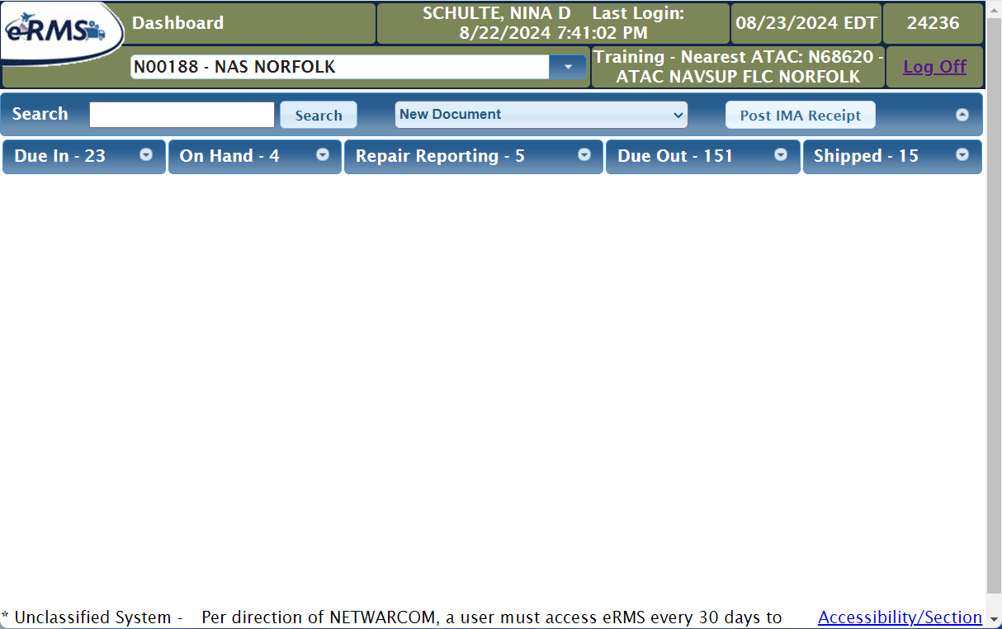





RDO PROCESS for DLRs being sent for Repair
WSS
DLA
ATAC
1st Coast Cargo
WSS TARP
RDO submitted
via ERP
Pick / Pull
24 HRS. ERMS
Assign Pickup to 1st CC
RDO Shipment Received at 1st CC
WSS TARP Screening Process
The legend shows the colors used for each group/roll responsible for that task.
?
Return Asset
to DLA
Process MisID/Qty+ as a KTR in eRMS
Return to ATAC within Contractor Returns
YES
Mis-Identified
Asset or Quantity Overage
On the Animation Pane, change the START option to ON CLICK if you want to click to step through the flow manually.
During presentation and while the animations are running and you want the animation to display the whole screen, just click the screen a second time.
NO
?
Packaging is Corrected and/or Documentation is Regenerated
YES
Packaging or Documentation Deficiencies
Not Shown:
SDR submission to officially record discrepancies
CAV data entry to record return to the ATAC/DLA (i.e. NERP Inventory Adjustments)
SIT is still open for returned items until the 90-day mark
NO
Repaired Asset Returned to DLA/Stow
Schedule 1st CC Delivery to Vendor

Slide 10

CAV Questions or Concerns
YOUR ACTION | THE RESULTS
Shipping material offsite of the eRMS/ATAC process. | Shipping won’t feed eRMS. Supply System not able to maintain 100 percent visibility of the RFI Assets & denial of invoice for shipping costs.
Requesting shipping labels prior to material being ready for shipment. (i.e. QA inspection, DCMA signed off requirement etc.) | Loss of man-hours due to having to cancel and recreate AWB labels.
Shipping labels provided but not used by Vendors. | Loss of man-hours due to cancelation of labels and it will create unnecessary SIT research.
Consolidating material. | Adds value and efficiency to the supply chain. Drives down Government transportation cost. Takes advantage of transportation network.

Slide 11
Contractor Inquiries
Why labels are not getting send directly to commercial vendors?
  Point of contact information is not getting properly updated
How to contact ATAC?
  Please email ATAC Customer Service at ATACCustomerService@us.navy.mil or call at (877) 846-8728 for support
Why commercial vendors missing PUDs?
  The CAV-RP/ERP/eRMS interface is not working properly
Who to contact if PUD doesn’t get properly loaded?
  The CAV analyst
  NAVSUP WSS Transportation Team
Can ATAC ship Hazardous, Classified or Radioactive material?
  Hazmat as long as the material is properly certified for transportation
  Classified and Radioactive are ATAC exclusions and transportation needs to be arranged via DCMA or Local TMO

Slide 12
NAVSUP WSS Points of Contact
POC | Phone Number | Email | Title
Nancy Powers | 215-697-9477 | nancy.c.powers2.civ@us.navy.mil | Repairable Distribution Director/ATAC PM
Robert Day | 215-697-9985 | robert.a.day40.civ@us.navy.mil | TARP PM
Steave Geary | 215-697-3296 | stephen.m.geary2.civ@us.navy.mil | Financial SME
Alex Sanchez | 215-697-2620/ 609-214-9213 | alexander.gaviriasanchez.civ@us.navy.mil | eRMS PM/Transportation SME
Wynetta Tucker | 215-697-4055 | wynetta.v.tucker.civ@us.navy.mil | Supply System Analyst
Ray Robinson | 215-697-1061 | ray.l.robinson6.civ@us.navy.mil | CRRC
Holly Roddy |  | holly.e.roddy.civ@us.navy.mil | Supply System Analyst
Rachel Steintmetz |  | rachel.m.steinmetz.civ@us.navy.mil | Supply System Analyst

Slide 13
ATAC Points of Contact
ATAC Customer Service Team: *Missing labels, all customer inquiries
ATACCustomerService@us.navy.mil Or Call (877) 846-8728
*CASREP Team:
Marvin Rosal marvin.m.rosal.civ@us.navy.mil
Edgar Taddle edgar.m.tadle.civ@us.navy.mil Jed Reyes jed.c.reyes2.civ@us.navy.mil - Lead Ricardo Torres ricardo.o.torres2.civ@us.navy.mil - Escalation
pauline.p.moore.civ@us.navy.mil - Supervisor

Slide 14
Questions???

